Slide 1

Seasons of change
UNIT PLAN

Slide 2
Overview
We will be doing an eight week unit plan over the different seasons, spending two weeks on each season. There will be a variety of projects throughout the eight weeks that you will complete. We will be using the classroom website, apps on your iPad’s, and many other resources to complete the projects.

Slide 3
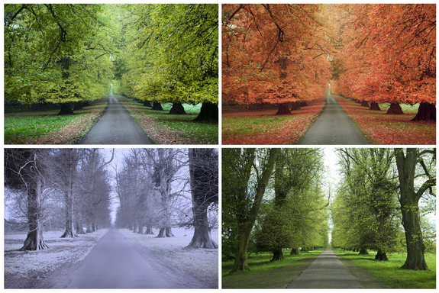
Do you know the different seasons??
SUMMER
Autumn (fall)
WINTER
SPRING

Slide 4

Weeks one and two
Spring

Slide 5
Week one
Go to the class room website: http://mschelseawiler.weebly.com/ and click on the seasonal tab.
Collect information about spring and save it to your iPad.
Make a short power point presentation no longer than 4 slides and present it to the teacher on the last day of the week. One of the slides need to be about what your favorite thing to do during the spring is.

Slide 6

Week Two
The teacher is going to introduce a book about spring to the class. The class will have a short discussion about what they think the book will be about.
After the discussion, the teacher will read the book to the class.
Students will receive a worksheet about the book and should turn it in to the teacher by the end of the day.
The students will get on the app “explain everything” on their iPad. You will need to draw a picture of your favorite part of the book and write a short paragraph explaining why it is your favorite part.

Slide 7

Weeks three and four
SUMMER

Slide 8
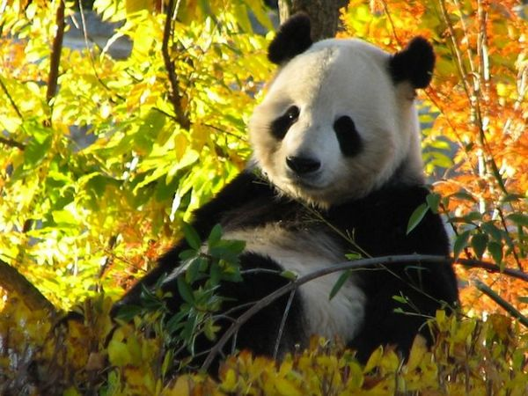
Weeks Three and Four Cont.
Time for the Web Quest!!

Slide 9
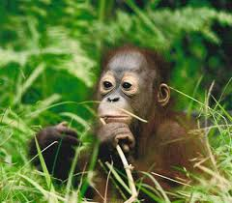
Weeks Three and four
Students will be completing their web quest for the next two weeks.
The teacher will break the students into partners.
In each pair, both students will have a different job to do through out the web quest. The jobs will be assigned by the teacher.
To access the web quest, go to the classroom website, http://mschelseawiler.weebly.com/ and click on the web quest tab.
Adventure to the zoo!!

Slide 10
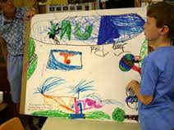
Week three and four cont.
After you have completed the web quest, each pair will make a presentation about their web quest and what they found out during it. You will present your presentation to the class.

Slide 11
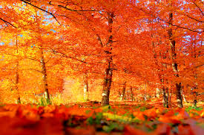
WEEKS FIVE AND SIX
AUTUMN (FALL)

Slide 12

Week Five
Go to the website http://blog.livepsychicsnetwork.com/uncategorized/fun-and-interesting-autumn-facts/ or http://kids.lovetoknow.com/wiki/Autumn_Facts_for_Kids
Explore the two websites and pick which one is your favorite

Slide 13
Week five Cont.
After you picked your favorite website, pick one of the facts on the website that interest you or stand out to you
Write a paragraph on why you picked the fact that you did and have the teacher review it
Read your paragraph to the classroom

Slide 14
Week Six
Lets make a Turkey!!
The video below will show you how to complete the project

Slide 15
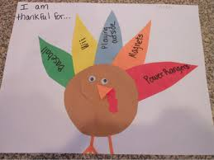
Week Six Cont.
After watching the video, write five things you are thankful for down on a piece of notebook paper.
Give them to the teacher so she can correct any mistakes made
When you receive your paper back, start on the project. You can go back to the video for help.
After you have finished making your turkey, you will pick one of the things you are thankful for and tell the class why you chose to write about it.

Slide 16

Weeks Seven and Eight
Winter

Slide 17


Week seven
Go to the class room website: http://mschelseawiler.weebly.com/ and click on the seasonal tab.
Collect information about winter and save it to your iPad.
Make a short power point presentation no longer than 4 slides and present it to the teacher on the last day of the week. One of the slides need to be about what your favorite thing to do during the winter is.

Slide 18
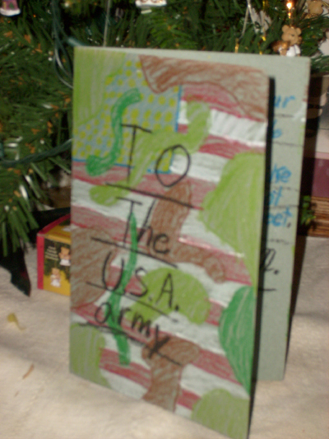
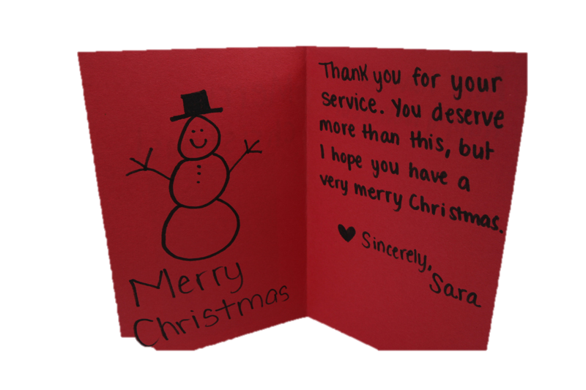
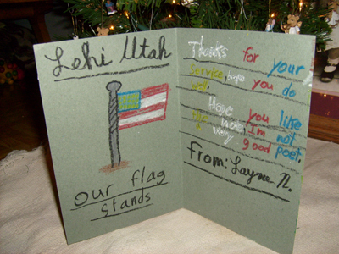
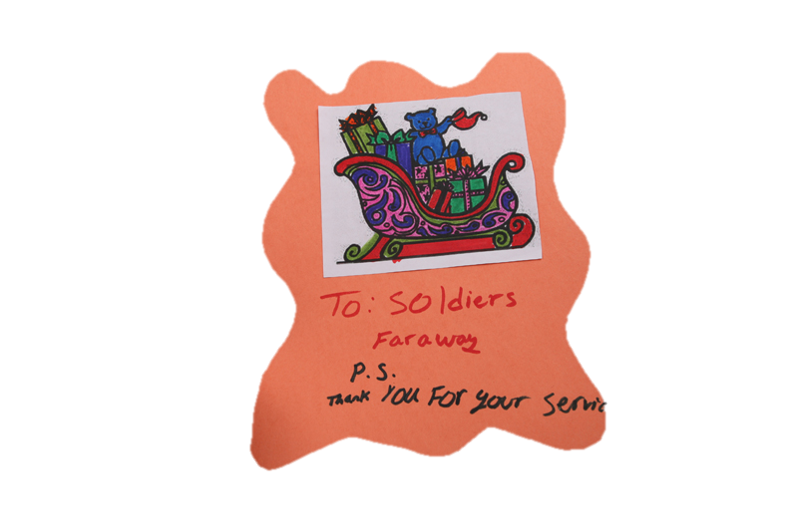
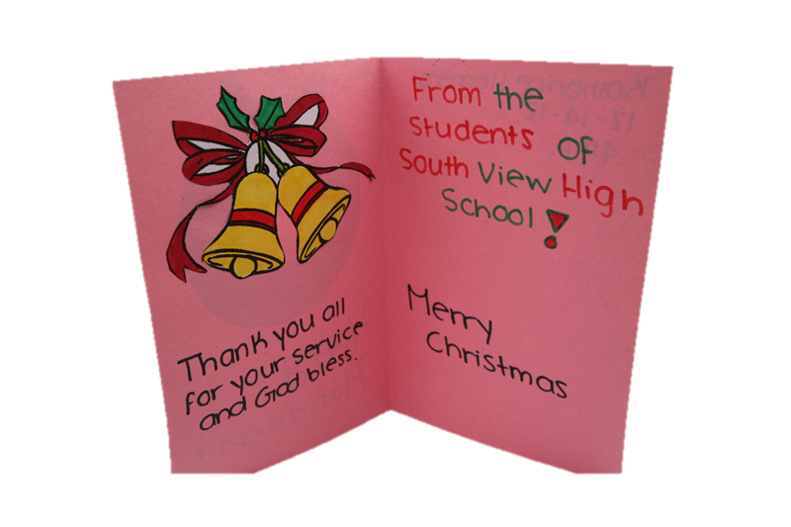
Week eight

Slide 19
Week eight cont.
We are going to be making Christmas cards for soldiers!!!
Samples of Christmas cards will be passed around the classroom for you to look at and get ideas for your own card.
Once you have an idea, I will have construction paper, markers, crayons, etc. for you to start making your cards.

Slide 20
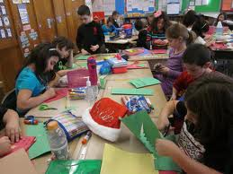
Week Eight cont.
Students will present their cards to the class on the last day of the week and tell the class one reason on why they think it is important to send Christmas cards to the troops.

